Slide 1


Multimodal Music Information Classification System
WhatTrack
Presented by Group 18:
Sathila Samarasinghe
Thareen Withanage
Ishan Fernando
Rizky Jezuli
Supervised by
Ms Sachinthani Perera

Slide 2
Agenda
Introduction
Research Gap
Project’s Aim
System Design
Implementation
Testing and Evaluation
Limitations
Business Canvas Model
Conclusion
Individual Contribution
Summary
Future Enhancements
Demonstration

Slide 3
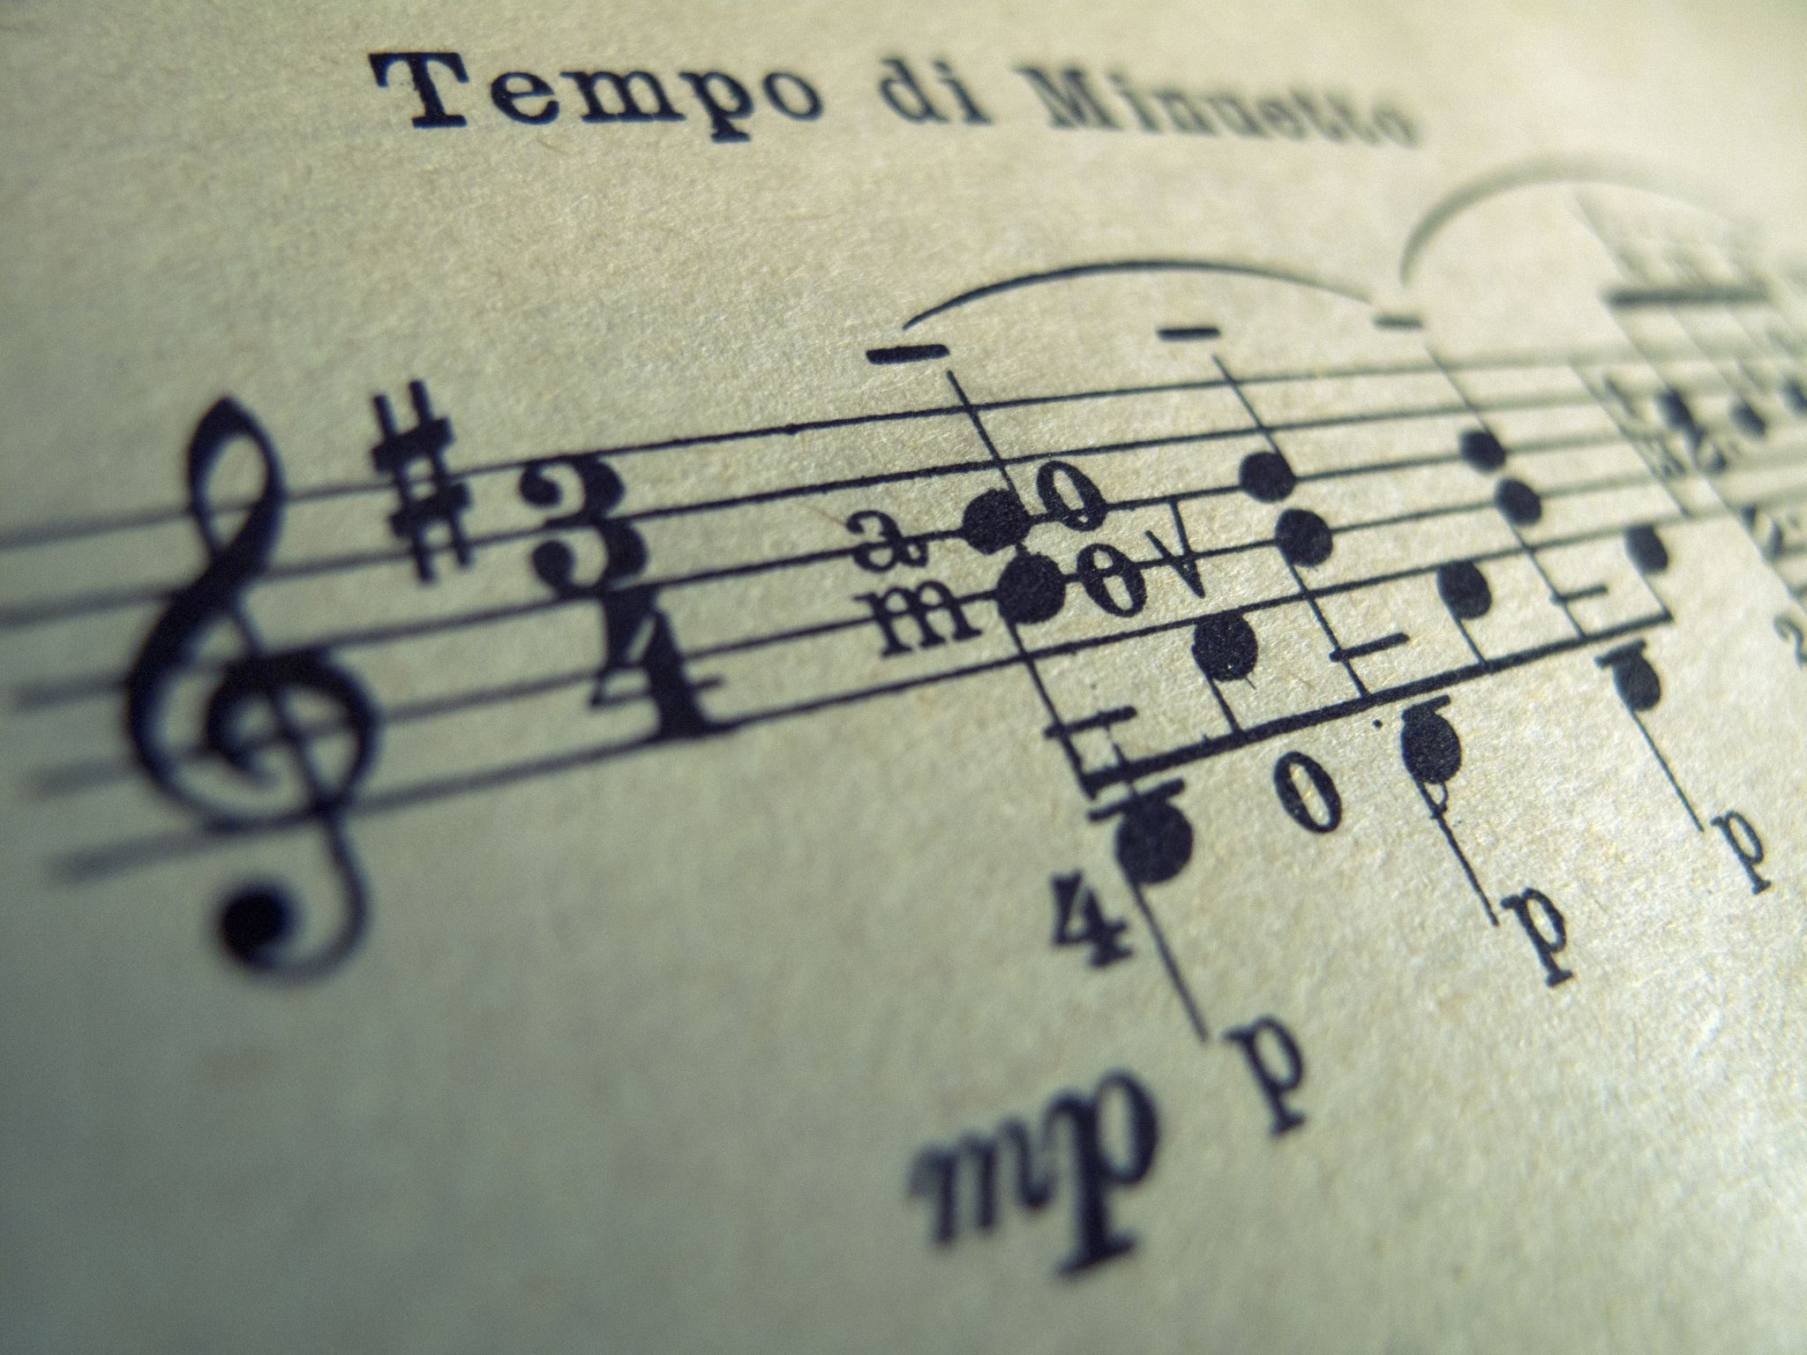
Introduction
Ordinary music listeners do not have the ability or the training to identify most of the hidden details in a music track such as the genre, the musical instruments used, music chords, and more which limits their ability to find similar music tracks they might enjoy.

Slide 4
Research Gap
The gap we are trying to work on is to educate people about music knowledge. To do that we are using the above mentioned three models as a collective.
There are existing systems which are used to classify music genres. But there are no existing applications which has ability to Classify Genres, Recommend Music, Chords Classification and Instrument Type Prediction as a collective in one application.

Slide 5
Project’s Aim
Classify music information and give any music listener the much-needed basic knowledge about music.

Slide 6
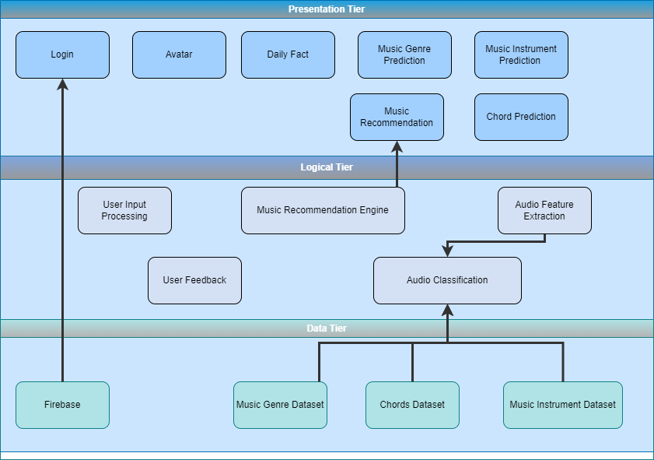
System Design

Slide 7






Implementation
Python
Dart
Firebase
Flask
Android Studio, VS Code
Technology Stack
Librosa, Scikit learn
TensorFlow
Pycharm, Jupyter Notebook
Github

Slide 8
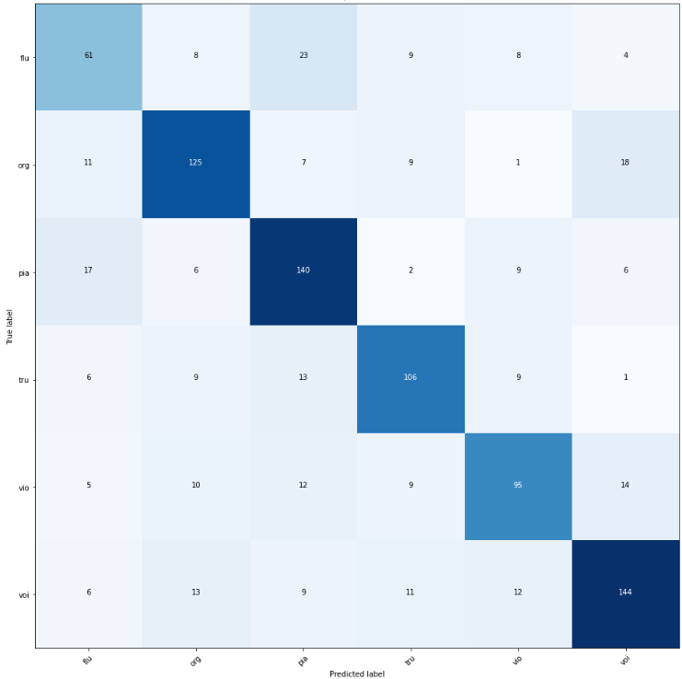
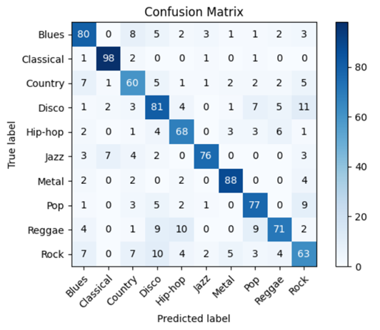
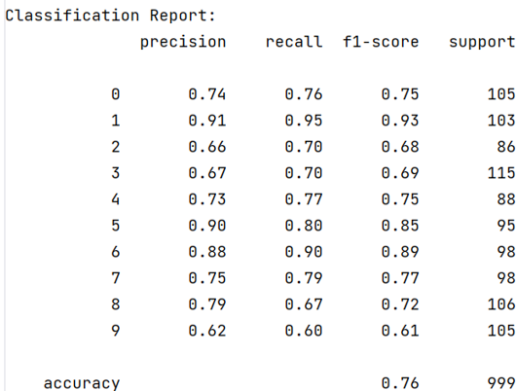
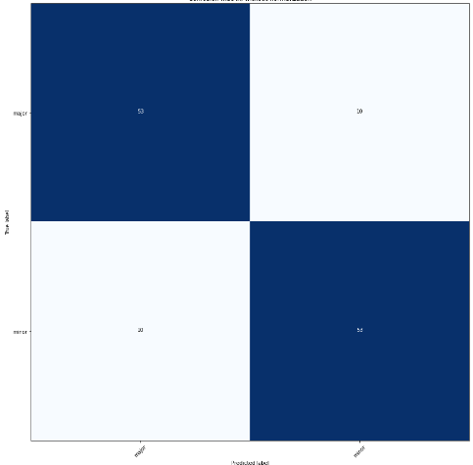
Testing and Evaluation
Testing Criteria:
Accuracy
Precision
Recall
F1 Score

Slide 9
Limitations
Model | Limitations
Music Genre Classification | The model can detect only 10 music genres. The model works with the best accuracy only for audio files that are 30 seconds long. Allows only wav files.
Music Instruments Prediction | The model can detect only 6 instruments. Works with the best accuracy only for audio files less than 5 seconds. Audio input should be a single instrumental sound. Allows only wav files.
Major Minor Chords Prediction | The model trained for audio files which are 3 seconds long. Audio input should be a single music chord (played from a guitar or piano) Allows only wav files.

Slide 10
Future Enhancements
Enable users to input lengthy audio files
Increase the number of genre/instrument/chords classes
An inbuilt music player
Utilizing user history to develop an efficient music recommendation engine
A User guide

Slide 11
Business Canvas Model
Key Activities
Finding suitable datasets.
Developing ML models to detect music genres, music instruments, major/minor chords.
Recommending music based on genres.
Developing the user interface
Value Propositions
Detailed music information analysis in a single platform
Enables music creators, learners, and enthusiasts to better understand their music
Supporting music education and creation with AI technology
Customer Segments
Music creators, producers, DJs
Music students and teachers
Music enthusiasts and hobbyists
Platform is a multi-sided, catering to both mass and niche markets
Customer Relationships
User support through in-app user Feedback forms.
Regular app updates and new feature introductions.
Active community engagement through social media and forums.
Key Partners
Spotify – Access music data via Spotify API
Google Play Store and Apple Store for distribution
Channels
Direct distribution through app stores (iOS, Android).
Collaborations with music platforms and schools.
Marketing via social media, online ads, music events
Cost Structure
AI technology development and maintenance costs
Marketing and customer acquisition costs
App store fees
Revenue Streams
Freemium model with in-app purchases for advanced features.
Subscription fees for premium version.
Advertising for music related products and services.

Slide 12
Conclusion
New Skills | Existing Skills | Challenges
Proficiency in preprocessing audio datasets for CNN. Working with Deep Learning Algorithms like CNN. Mobile App development using flutter. Flask API Firebase | Data preprocessing and manipulation. Machine Learning Algorithms. Python. Model evaluation. Version control using GitHub | Steep learning curve VS limited time Issues with datasets Balancing accuracy and speed of ML Models. Hardware requirements New tools and technologies

Slide 13




Individual Contribution
Sathila Samarasinghe
Ishan Fernando
Audio feature extraction and preprocessing for music genre classification.
User input preprocessing and prediction of music genre classification
Accuracy testing for music genre classification
Daily music fact generator
Preprocessing data for major minor chord prediction.
UI designing
Login page, authentication, and security
Integration of frontend and backend using Flask.
Integration of Firebase to collect user information.
Random avatar image to the profile based on gender.
Thareen Withanage
Rikzy Jezuli
Preprocessing data for instruments classification
KNN model for instrument classification.
Accuracy testing for chord prediction.
Accuracy testing for instrument prediction
CNN model for music genre classification.
Music Recommendation Engine from Spotify API
User feedback page to improve music recommender and predicted results.
Documentation.

Slide 14
Summary
Our project aims to classify music audio tracks according to three components which are music genres, instrument type and major/minor. We have mentioned the design, implementation process and steps taken to create the models. Additionally, we have described the limitations, future enhancements and acknowledged the individual contributions made by our each member of the team to make this project a success.

Slide 15
Demonstration

